Slide 1
Introduction to Kubernetes for Developers
Jason L. van Brackel
TechBash 2025

Slide 2




CONTACT ME
Jason van Brackel
Jason van Brackel
@JvB
@jasonvanbrackel
jasonvanbrackel

Slide 3
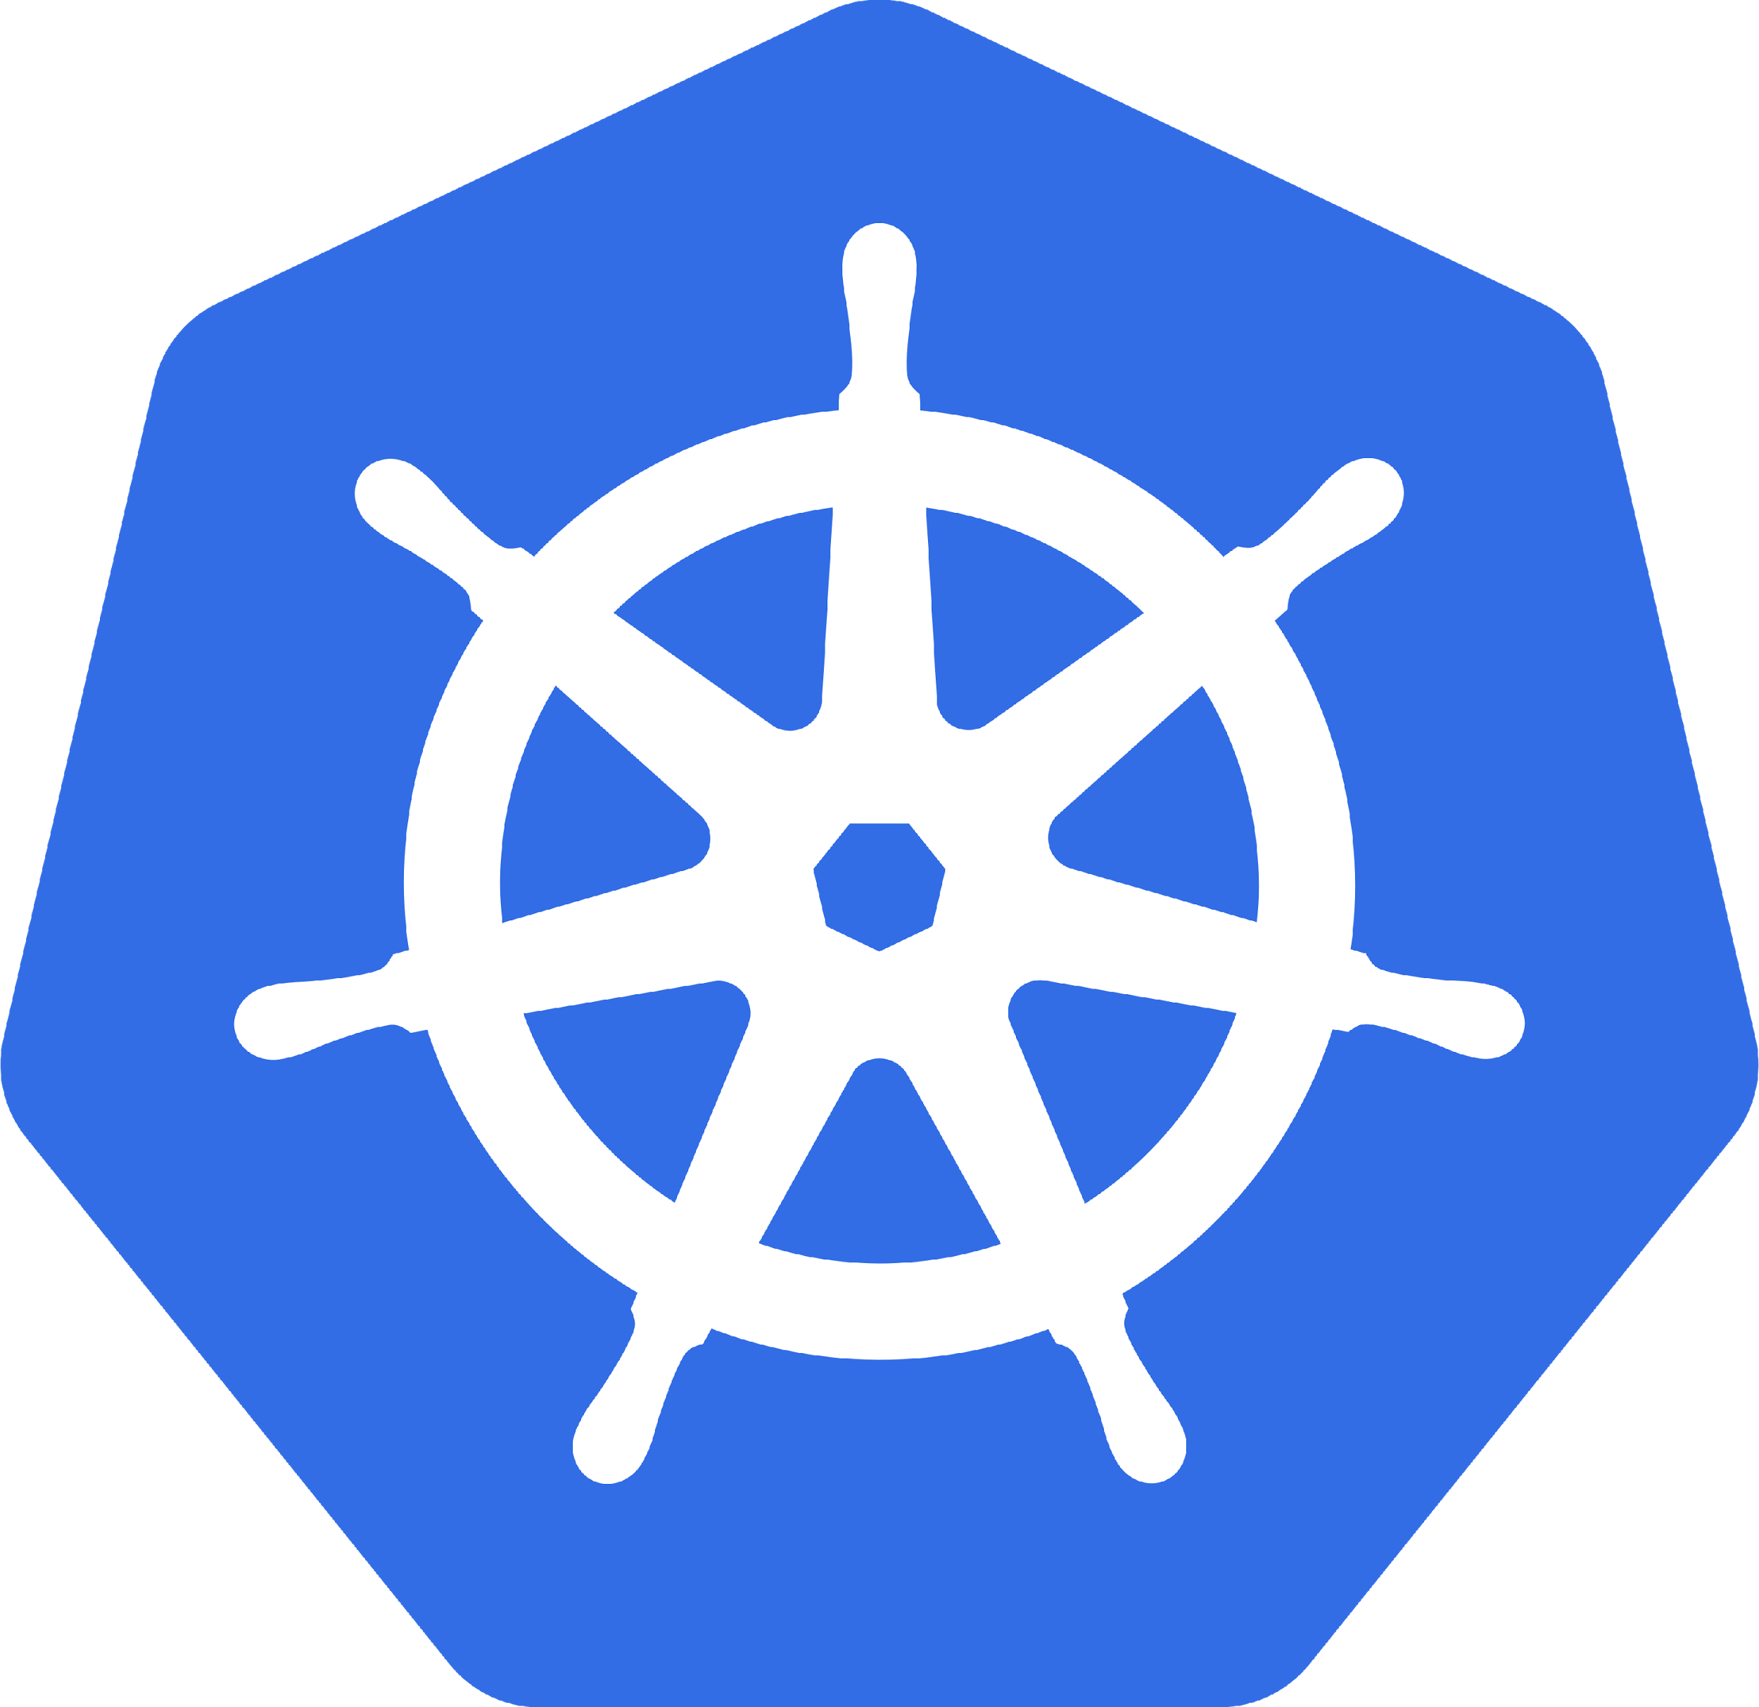
What is Kubernetes
Orchestrates Containers
That’s it? That’s all it does!

Slide 4

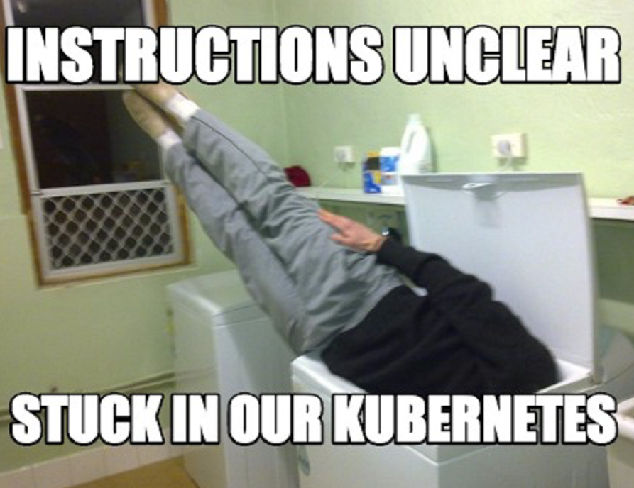

It Is Complex
Scale
Kubernetes Reference API
What is Kubernetes Physically Speaking?

Slide 5
Why Should I care?
Developers
Operators
It’s Everwhere

Slide 6

Why Should Developers care?
Containerized Applications
Breaking the Monolith
It’s the Substrate

Slide 7
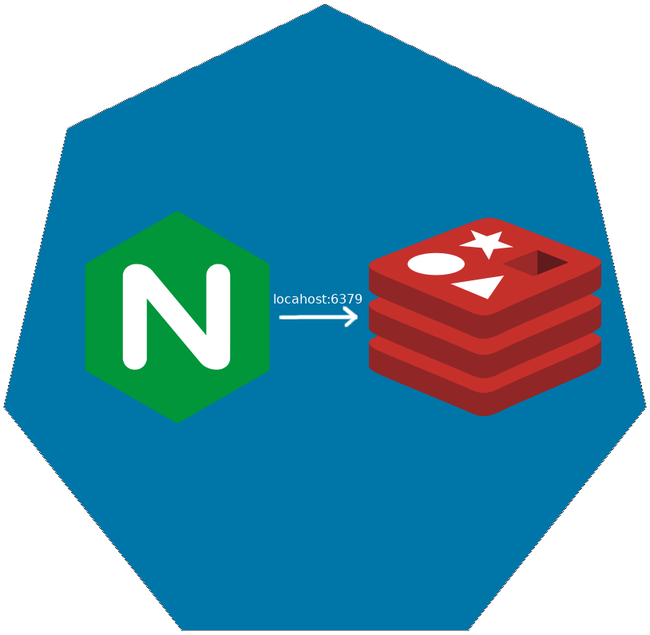
Pod
Co-scheduled
Shared Network Namespace
Shared Files System

Slide 8

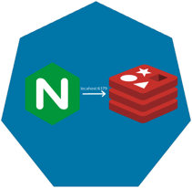
ReplicaSet

Slide 9

ReplicaSet

Slide 10
ReplicaSet

Slide 11
Deployments

Slide 12
Deployments

Slide 13
Deployments

Slide 14
Deployments

Slide 15
Deployments

Slide 16
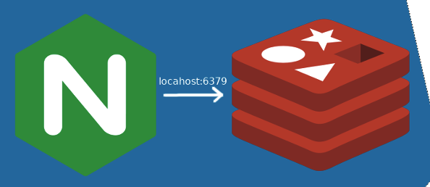
How are these Connected?
Deployment
Deployment
ReplicaSet
ReplicaSet
Manages
Manages
Manages
Manages
Pod
Pod
Manages
Manages
Containers
Containers

Slide 17
How are these Connected?
Deployment
Deployment
ReplicaSet
ReplicaSet
Selector
app=nginx
Pod
Selector
app=nginx
Labels
app=nginx
Labels
app=nginx
Labels
app=nginx
Selector
app=nginx
Pod
Selector
app=nginx
Labels
app=nginx
Containers
Containers

Slide 18
How are these Connected?
Deployment
Deployment
ReplicaSet
ReplicaSet
Selector
app=nginx
Pod
Selector
app=nginx
Labels
app=nginx
Labels
app=nginx
Labels
app=nginx
Selector
app=nginx
Pod
Selector
app=whatevs
Labels
app=whatevs
Containers
Containers

Slide 19
Services
Define a DNS entry that can be used to refer to a group of pods
Provide a consistent endpoint for the group of pods
Different types: nodePort, clusterIP, loadbalancer
#rancherk8s

Slide 20


Services (Node Port)
192.168.0.[1-3]:32000

Slide 21
Services (Load Balancer)
Public IP:80

Slide 22
Config Maps & Secrets
Allow storing of arbitrary configuration values and files
Exposed in pods as either environment variables or as local storage
Decoupled storage of configuration from pod spec
#rancherk8s

Slide 23
Config Maps & Secrets
apiVersion: v1
kind: ConfigMap
metadata:
name: dev-config
namespace: default
data:
Item1: dev-stuff
Item2: more dev stuff
apiVersion: v1
kind: ConfigMap
metadata:
name: qa-config
namespace: default
data:
Item1: qa-stuff
Item2: more qa stuff
apiVersion: v1
kind: ConfigMap
metadata:
name: prod-config
namespace: default
data:
Item1: prod-stuff
Item2: more prod stuff

Slide 24
Ingresses
Define how traffic outside the cluster is routed to inside the cluster
Used to expose Kubernetes services to the world
Route traffic to internal services based on factors such as host and path
Ingress is usually implemented by a load balancer (Nginx, HAProxy, AWS ELB, etc…)
#rancherk8s

Slide 25

Ingresses
Ingress Controller
https://my-nginx-app.cluster.com https://cluster.com/my-nginx-app

Slide 26
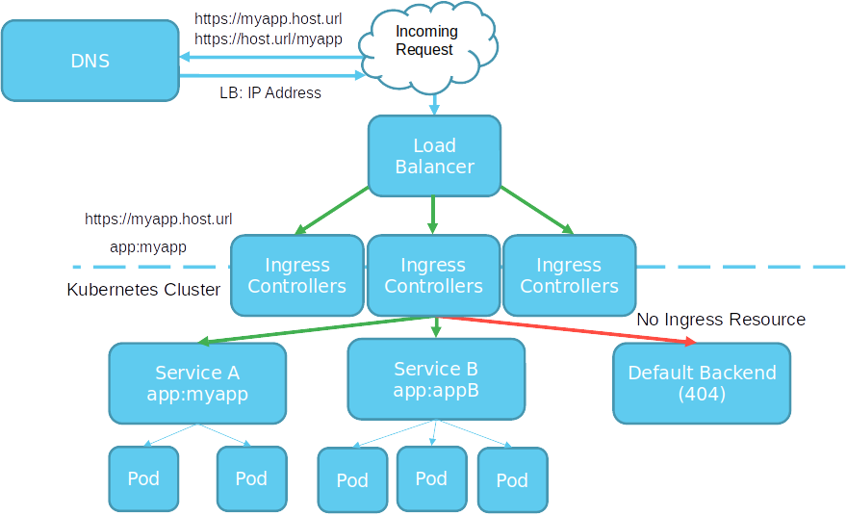

Slide 27
Tools
Running Kubernetes Locally
Running Kubernetes In The Cloud
Dealing with Scale

Slide 28
Running Kubernetes Locally
K3s
K3d
Rancher
Docker
Kind
KWOK

Slide 29
Running Kubernetes In the Cloud
AKS
EKS
GKE
Digital Ocean
Linode

Slide 30
Dealing with Scale
Find a framework you like
ELK
PLG
Don’t Over Alert

Slide 31
Application Deployment
Helm
Kustomize
Zarf

Slide 32
Packaging and Supply Chain Security
Chainguard
Zarf

Slide 33
The Kitchen Sink
https://landscape.cncf.io/

